Slide 1
Digital Logic & Design Boolean Algebra and Logic Simplification Lecture08
Notes:
‹#›

Slide 2
Boolean Algebra
Variable
Complement
Literal
Notes:
‹#›
Variable: A variable is a symbol usually an uppercase letter used to represent a logical quantity.
A variable can have a 0 or 1 value.
Complement: A complement is the inverse of a variable and is indicated by a bar over the variable.
Complement of variable X is X*
If X = 0 then X*= 1 and if X = 1 then X*= 0
Literal: A Literal is a variable or the complement of a variable. X and X* are literals

Slide 3
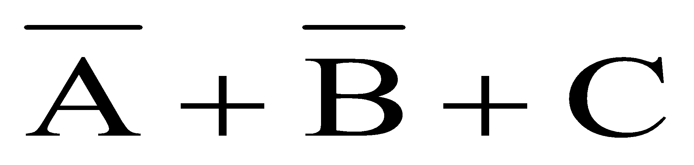
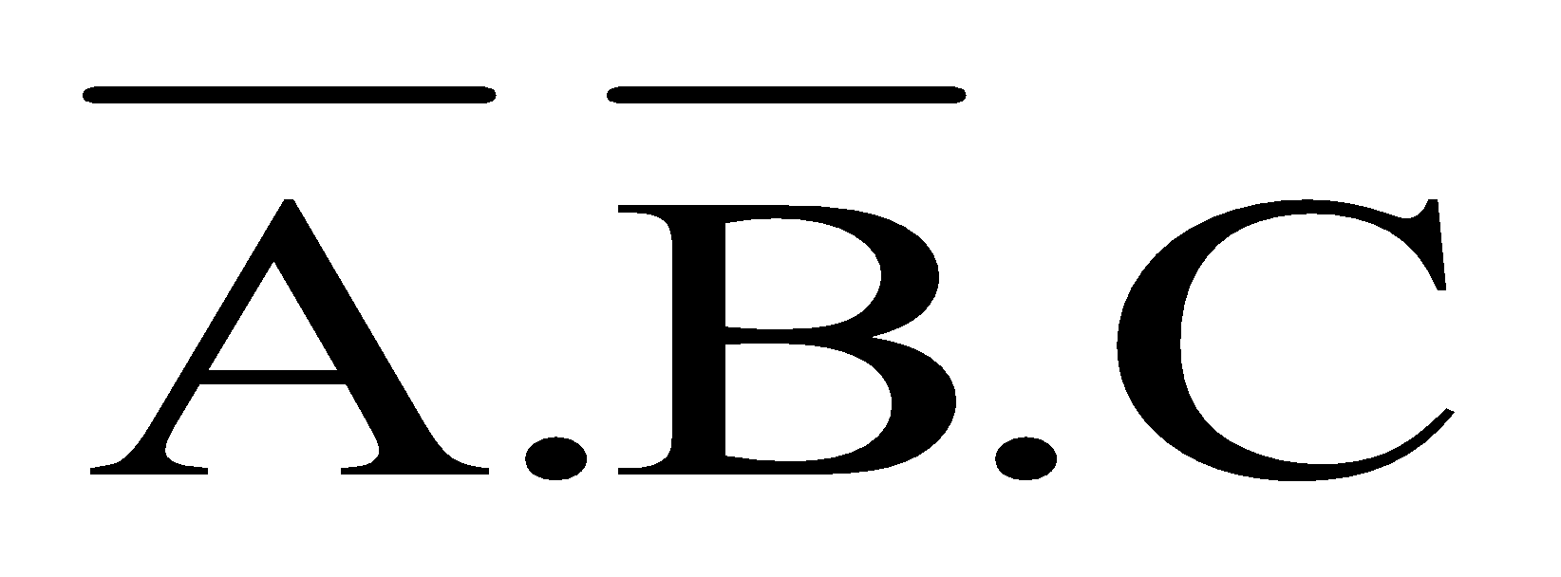
Boolean Addition & Multiplication
Boolean Addition performed by OR gate
Sum Term describes Boolean Addition
Boolean Multiplication performed by AND gate
Product Term describes Boolean Multiplication

Slide 4
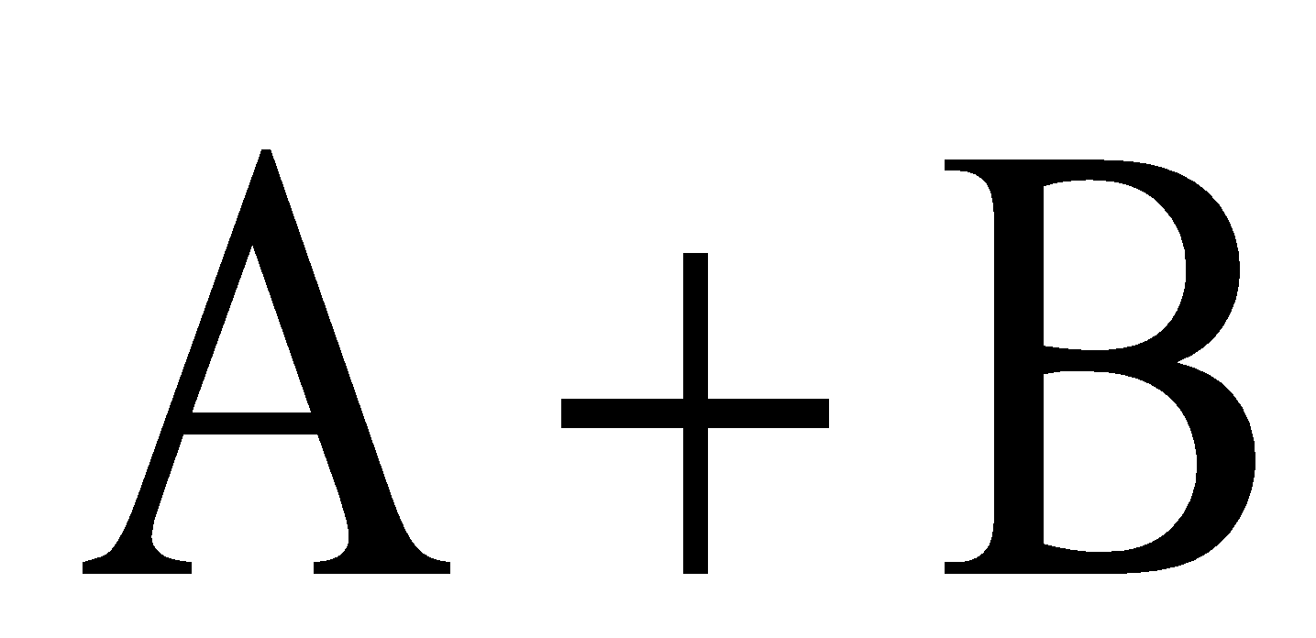
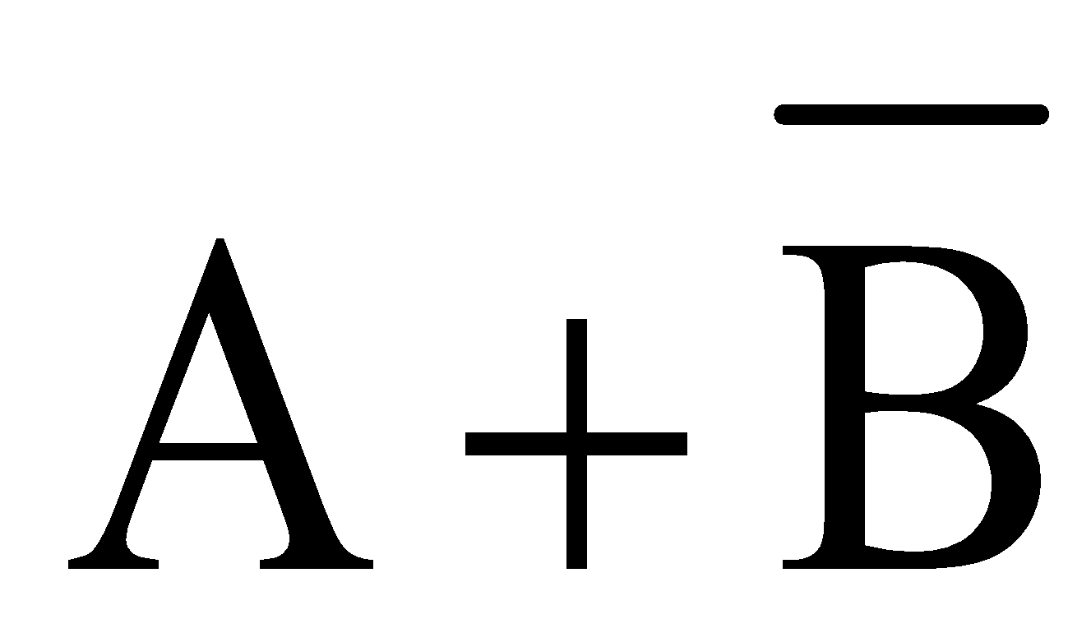
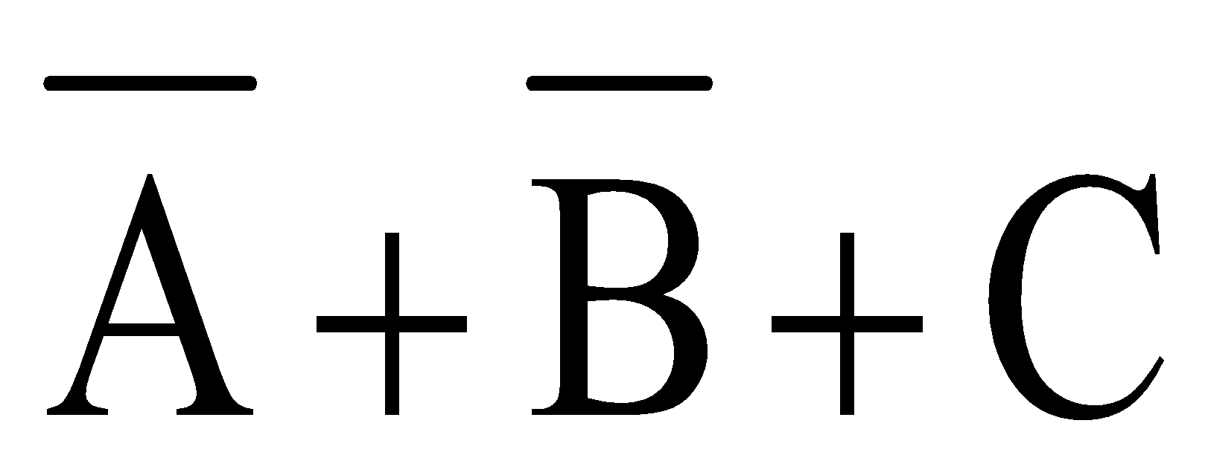
Boolean Addition
Sum of literals
Sum term = 1 if any literal = 1
Sum term = 0 if all literals = 0
Notes:
‹#›
Sum term is described as sum of literals

Slide 5

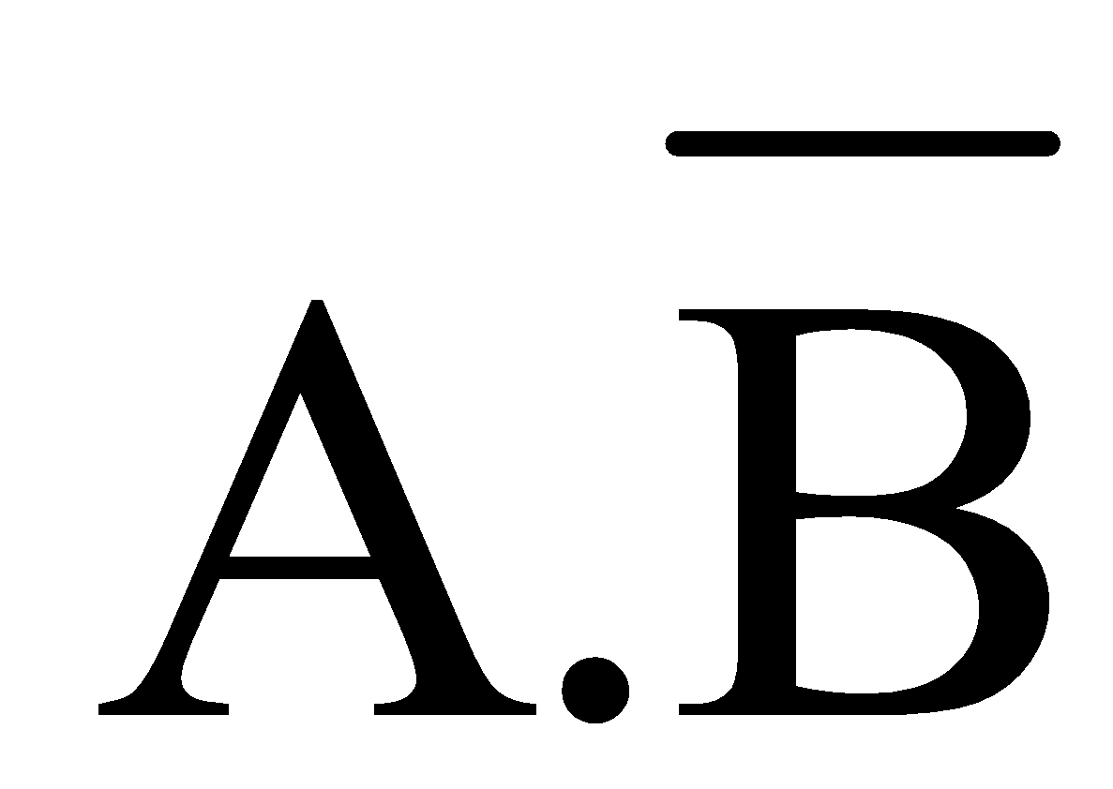
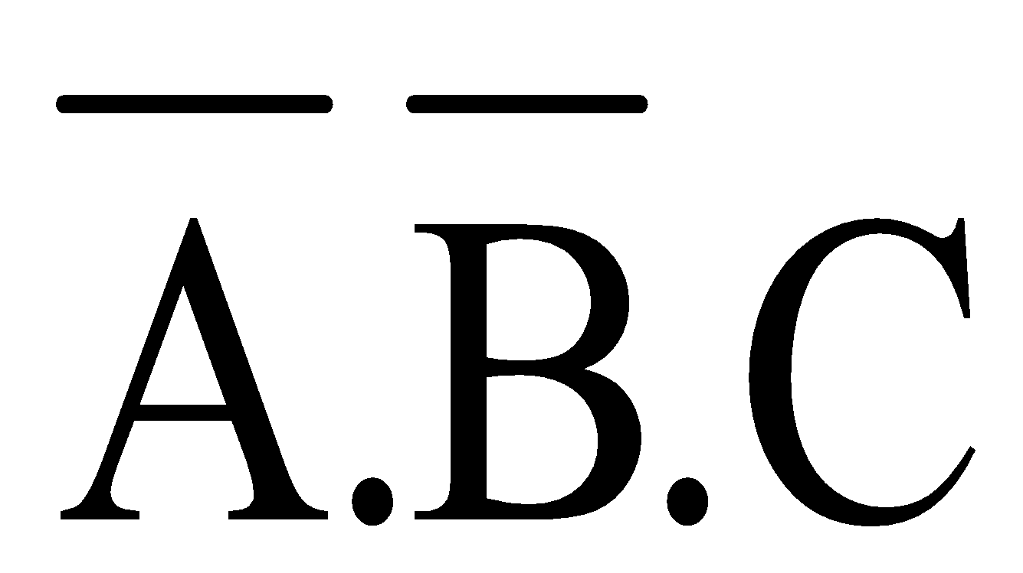
Boolean Multiplication
Product of literals
Product term = 1 if all literals = 1
Product term = 0 if any one literal = 0
Notes:
‹#›
Product term is described as product of literals

Slide 6
Laws, Rules & Theorems of Boolean Algebra
Commutative Law
for addition and multiplication
Associative Law
for addition and multiplication
Distributive Law
Rules of Boolean Algebra
Demorgan’s Theorems
Notes:
‹#›

Slide 7
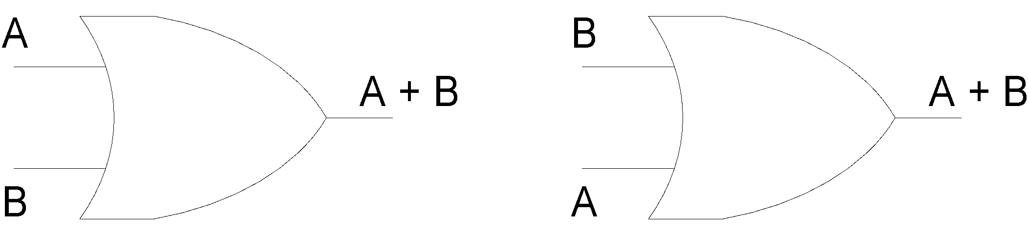
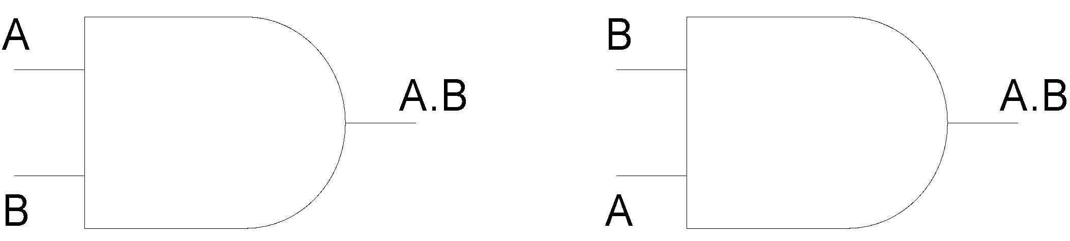
Commutative Law
Commutative Law for Addition
A + B = B + A
Commutative Law for Multiplication
A.B = B.A
Notes:
‹#›
The basic laws of Boolean Algebra are the same as ordinary algebra and hold true for any number of variables

Slide 8
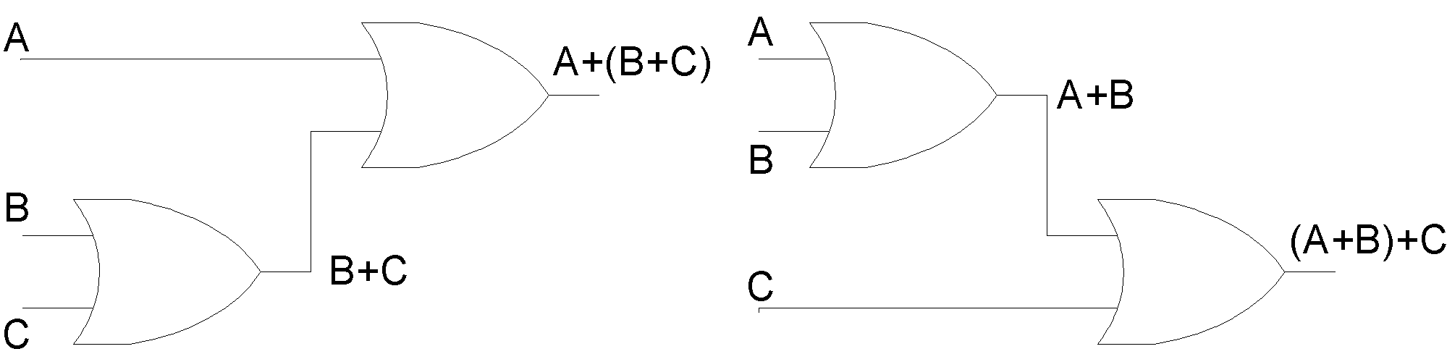
Associative Law
Associative Law for Addition
A + (B + C) = (A + B) + C
Notes:
‹#›
The sum term B OR C Ored with A is the same as sum term A OR B Ored with C

Slide 9
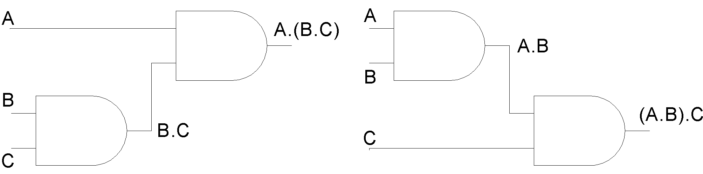
Associative Law
Associative Law for Multiplication
A.(B.C) = (A.B).C
Notes:
‹#›
The product term BC Anded with A is the same as AB Anded with C

Slide 10
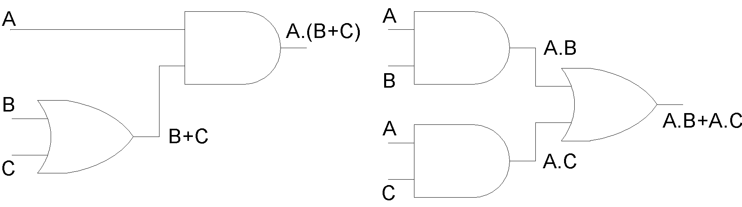
Distributive Law
A.(B + C) = A.B + A.C

Slide 11

Rules of Boolean Algebra
A + 0 = A
A + 1 = 1
A.0 = 0
A.1 = A
A + A = A
A + A = 1
A.A = A
A.A = 0
A = A
A + A.B = A
A + A.B = A + B
(A+B).(A+C)
= A+B.C
Notes:
‹#›
A+A*B = A(B+1)+A*B using rule 2
=AB+A+A*B
=A+AB+A*B
= A+B
(A+B)(A+C) = A+AC+AB+BC
=A+BC

Slide 12
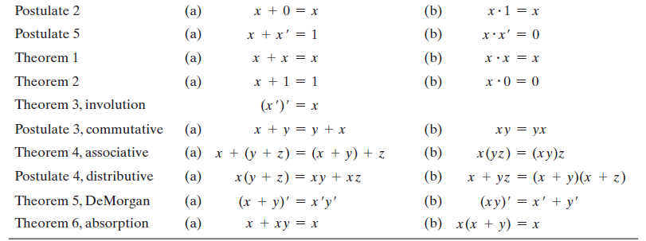
Rules of Boolean Algebra
Notes:
‹#›
A+A*B = A(B+1)+A*B using rule 2
=AB+A+A*B
=A+AB+A*B
= A+B
(A+B)(A+C) = A+AC+AB+BC
=A+BC

Slide 13
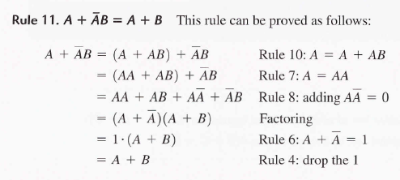
Rules of Boolean Algebra
Notes:
‹#›
A+A*B = A(B+1)+A*B using rule 2
=AB+A+A*B
=A+AB+A*B
= A+B
(A+B)(A+C) = A+AC+AB+BC
=A+BC

Slide 14
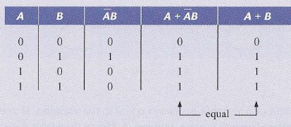
Rules of Boolean Algebra
Truth Table For Rule 11: A + A.B = A + B
Notes:
‹#›
A+A*B = A(B+1)+A*B using rule 2
=AB+A+A*B
=A+AB+A*B
= A+B
(A+B)(A+C) = A+AC+AB+BC
=A+BC

Slide 15
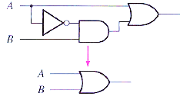
Rules of Boolean Algebra
Circuit Diagram For Rule 11: A + A.B = A + B
Notes:
‹#›
A+A*B = A(B+1)+A*B using rule 2
=AB+A+A*B
=A+AB+A*B
= A+B
(A+B)(A+C) = A+AC+AB+BC
=A+BC

Slide 16
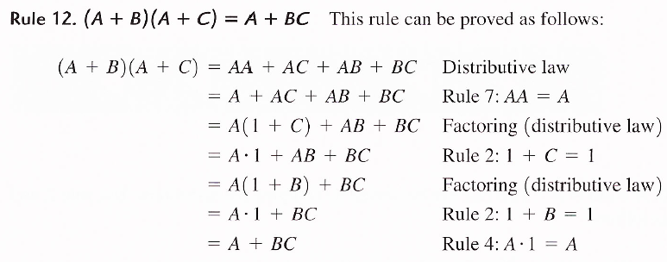
Rules of Boolean Algebra
Notes:
‹#›
A+A*B = A(B+1)+A*B using rule 2
=AB+A+A*B
=A+AB+A*B
= A+B
(A+B)(A+C) = A+AC+AB+BC
=A+BC

Slide 17
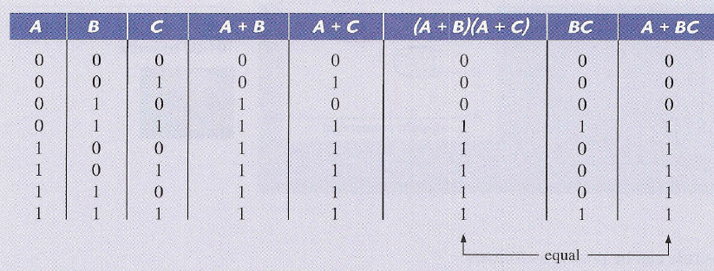
Rules of Boolean Algebra
Truth Table For Rule 12: (A+B).(A+C) = A + B.C
Notes:
‹#›
A+A*B = A(B+1)+A*B using rule 2
=AB+A+A*B
=A+AB+A*B
= A+B
(A+B)(A+C) = A+AC+AB+BC
=A+BC

Slide 18
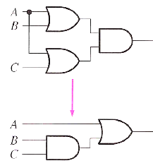
Rules of Boolean Algebra
Truth Table For Rule 12: (A+B).(A+C) = A + B.C
Notes:
‹#›
A+A*B = A(B+1)+A*B using rule 2
=AB+A+A*B
=A+AB+A*B
= A+B
(A+B)(A+C) = A+AC+AB+BC
=A+BC

Slide 19
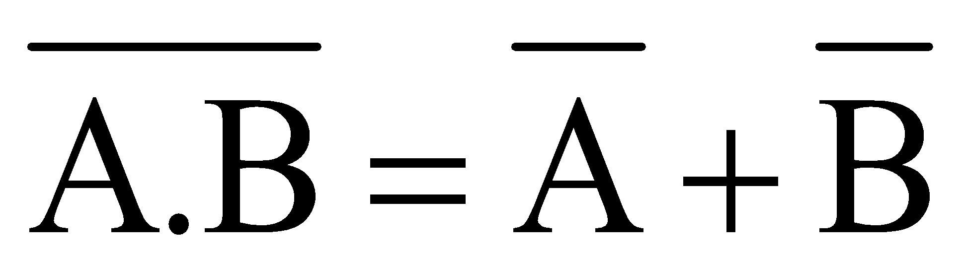
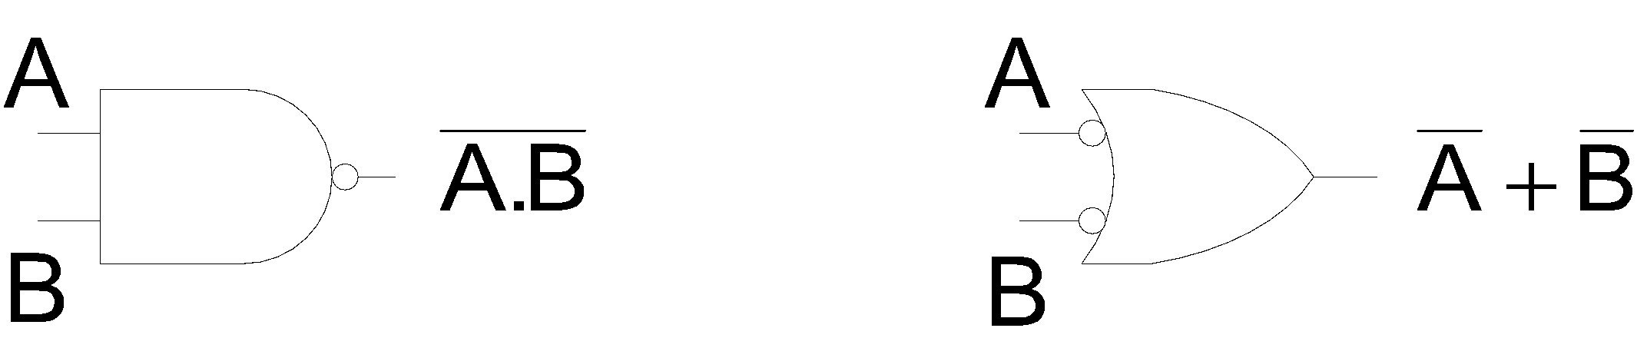
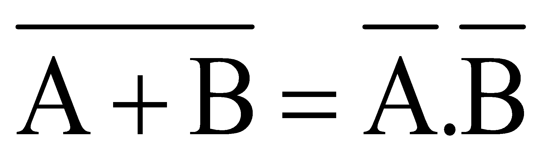
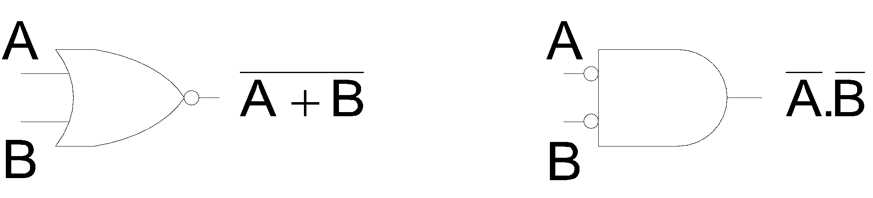
Demorgan’s Theorems
First Theorem
Second Theorem
Notes:
‹#›
Demorgan’s First Theorem states: The complement of a product of variables is equal to the sum of the complements of the variables.
Demorgan;s Second Theorem states: The complement of sum of variables is equal to the product of the complements of the variables

Slide 20
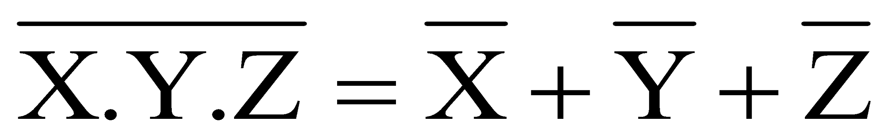
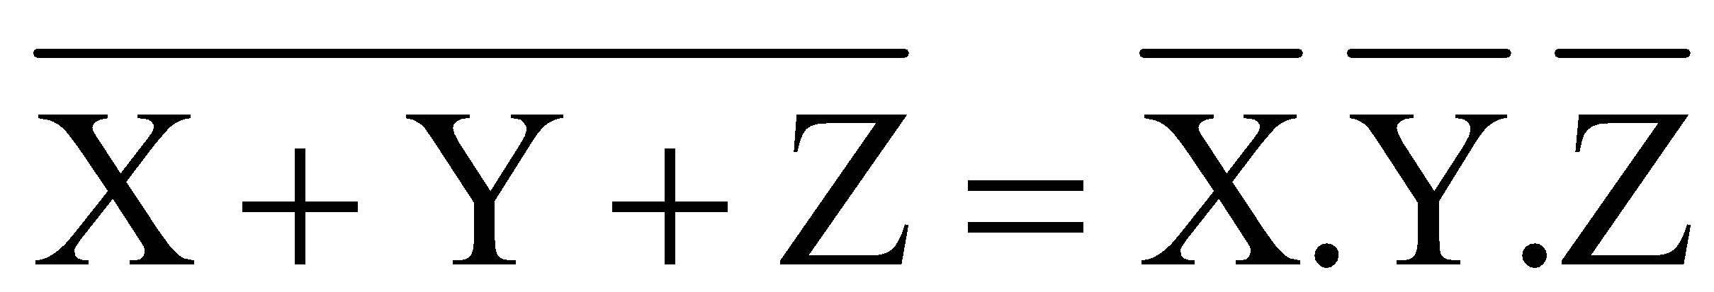
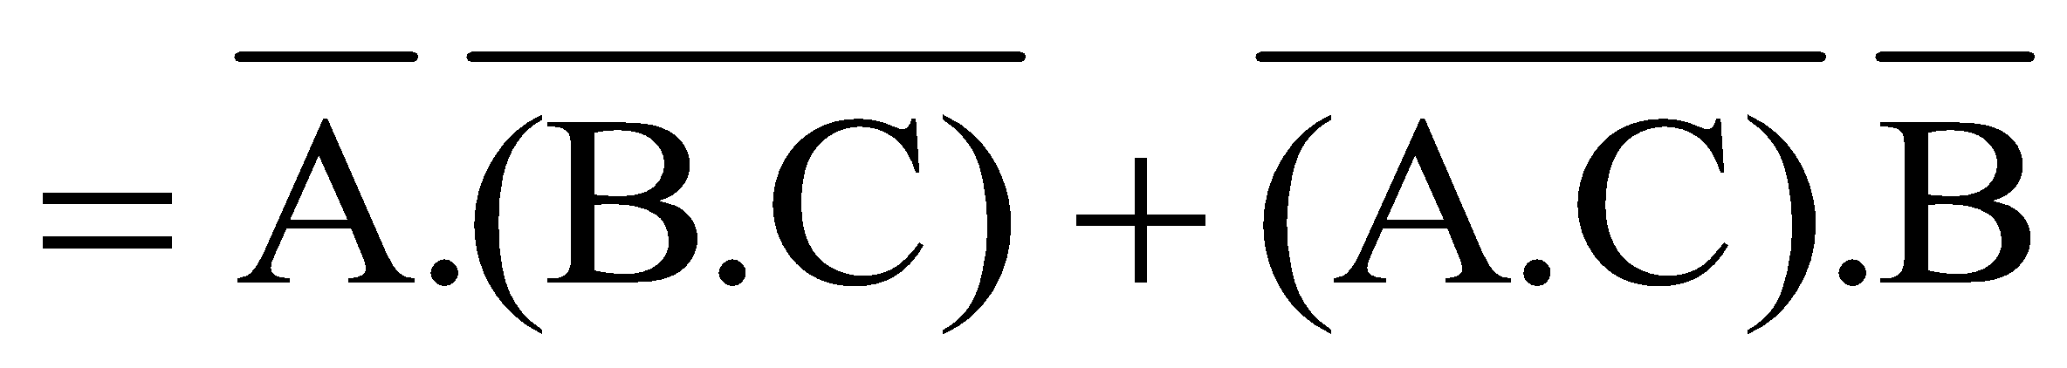
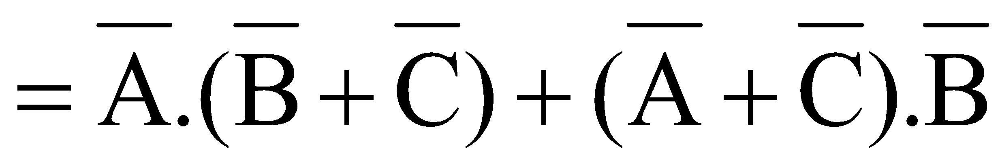
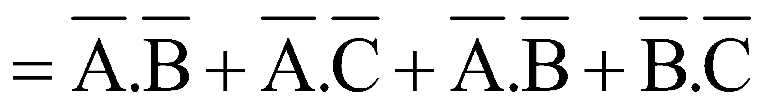
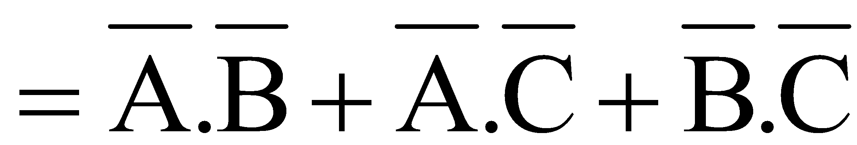
Demorgan’s Theorems
Any number of variables
Combination of variables
Notes:
‹#›
Demorgan’s Theorems can be applied to expressions having any number of variables
Demorgan’s Theorem can be applied to a combination of other variables

Slide 21
Boolean Analysis of Logic Circuits
Boolean Algebra provides concise way to represent operation of a logic circuit
Complete function of a logic circuit can be determined by evaluating the Boolean expression using different input combinations
Notes:
‹#›
Boolean algebra provides a concise way to represent the operation of a logic circuit.
The complete function of the logic circuit can be determined by evaluating the Boolean expression using different input combinations.

Slide 22
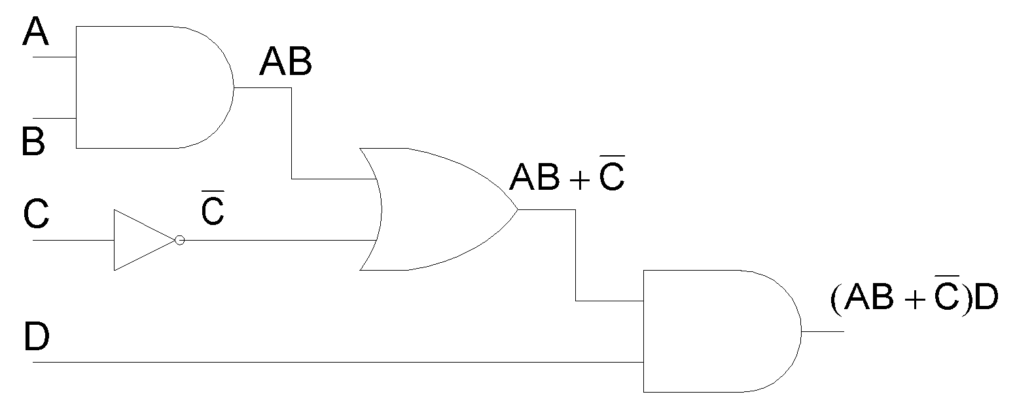
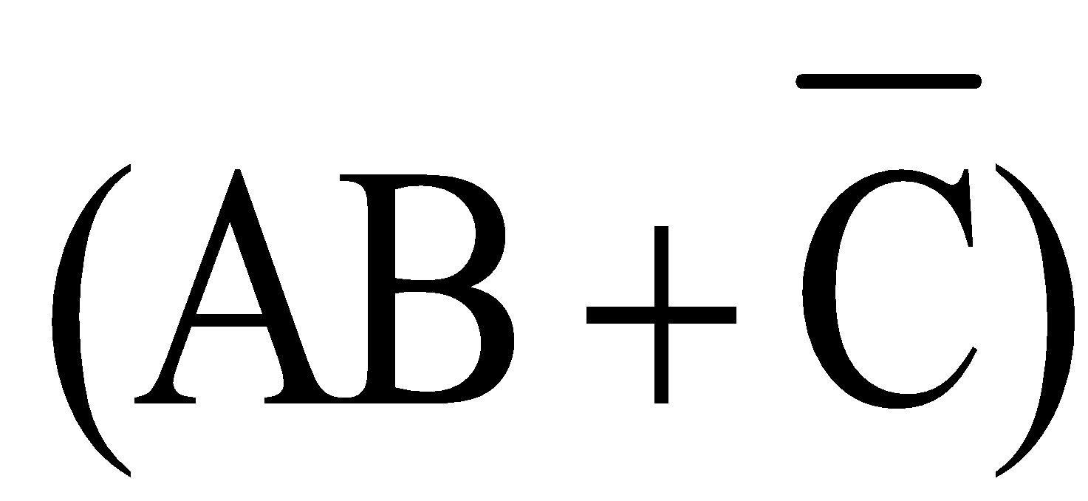
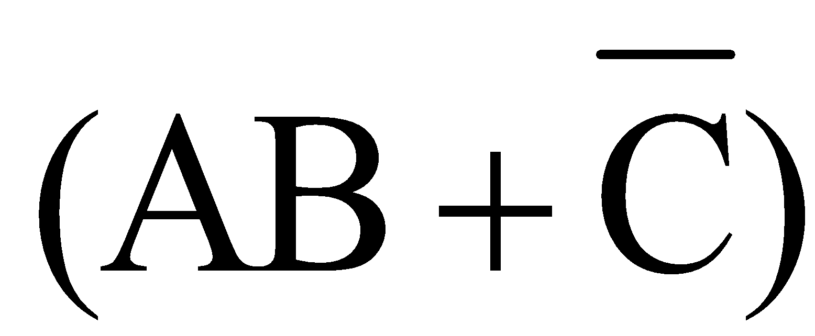
Boolean Analysis of Logic Circuits
From the expression, the output is a 1 if variable D = 1 and =1
=1 if AB=1 or C=0
Notes:
‹#›

Slide 23
Boolean Analysis of Logic Circuits
Inputs |  |  |  | Output | Inputs |  |  |  | Output
A | B | C | D | F | A | B | C | D | F
0 | 0 | 0 | 0 | 0 | 1 | 0 | 0 | 0 | 0
0 | 0 | 0 | 1 | 1 | 1 | 0 | 0 | 1 | 1
0 | 0 | 1 | 0 | 0 | 1 | 0 | 1 | 0 | 0
0 | 0 | 1 | 1 | 0 | 1 | 0 | 1 | 1 | 0
0 | 1 | 0 | 0 | 0 | 1 | 1 | 0 | 0 | 0
0 | 1 | 0 | 1 | 1 | 1 | 1 | 0 | 1 | 1
0 | 1 | 1 | 0 | 0 | 1 | 1 | 1 | 0 | 0
0 | 1 | 1 | 1 | 0 | 1 | 1 | 1 | 1 | 1

Slide 24
Simplification using Boolean Algebra
AB + A(B+C) + B(B+C)
= AB + AB + AC + BB +BC
= AB + AC + B + BC
= AB + AC + B
= B + AC
Notes:
‹#›

Slide 25
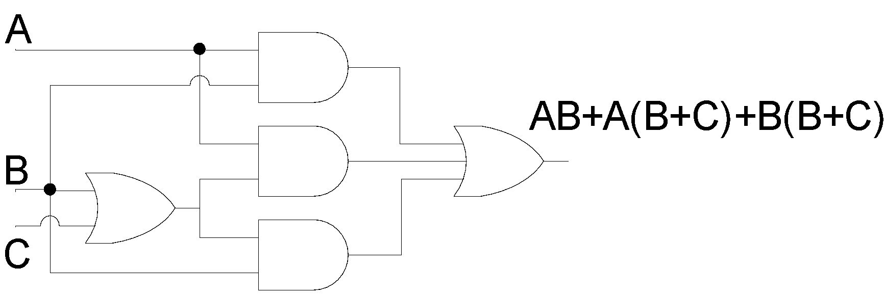
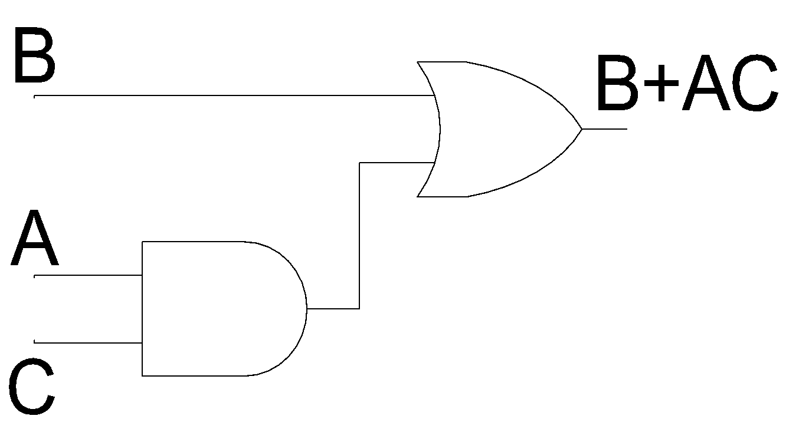
Simplified Circuit

Slide 26
Standard forms of Boolean Expressions
Sum-of-Products form
Product-of-Sums form
Notes:
‹#›
Sum-of-Product (SOP) form: When two or more product terms are summed by Boolean addition, the result is a Sum-of-Product or SOP expression
Product-of-Sum (POS) form: When two or more sum terms are multiplied by Boolean multiplication, the result is a Product-of-Sum or POS expression
The Domain of an SOP and POS expression is the set of variables contained in the expression, both complemented and un-complemented.
A SOP and POS expression can have a single variable term such as A
A SOP and POS expression can not have a term of more than one variable having an over bar extending over the entire term.

Slide 27
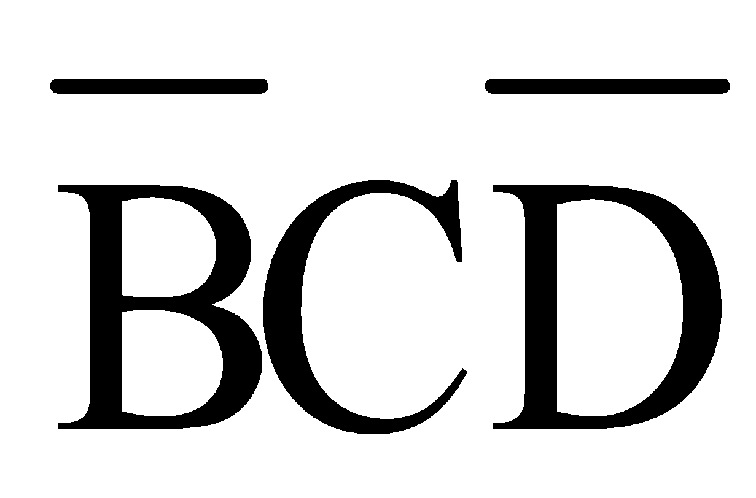
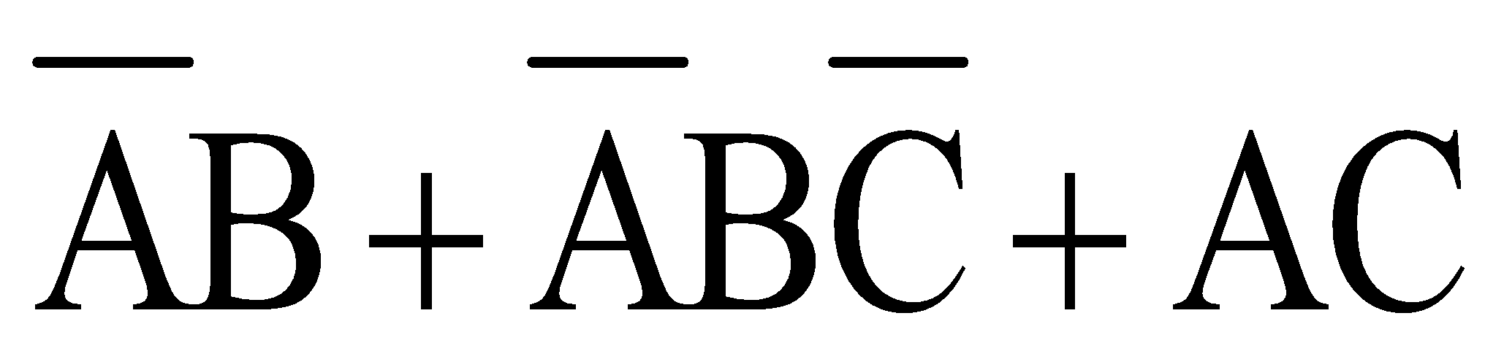
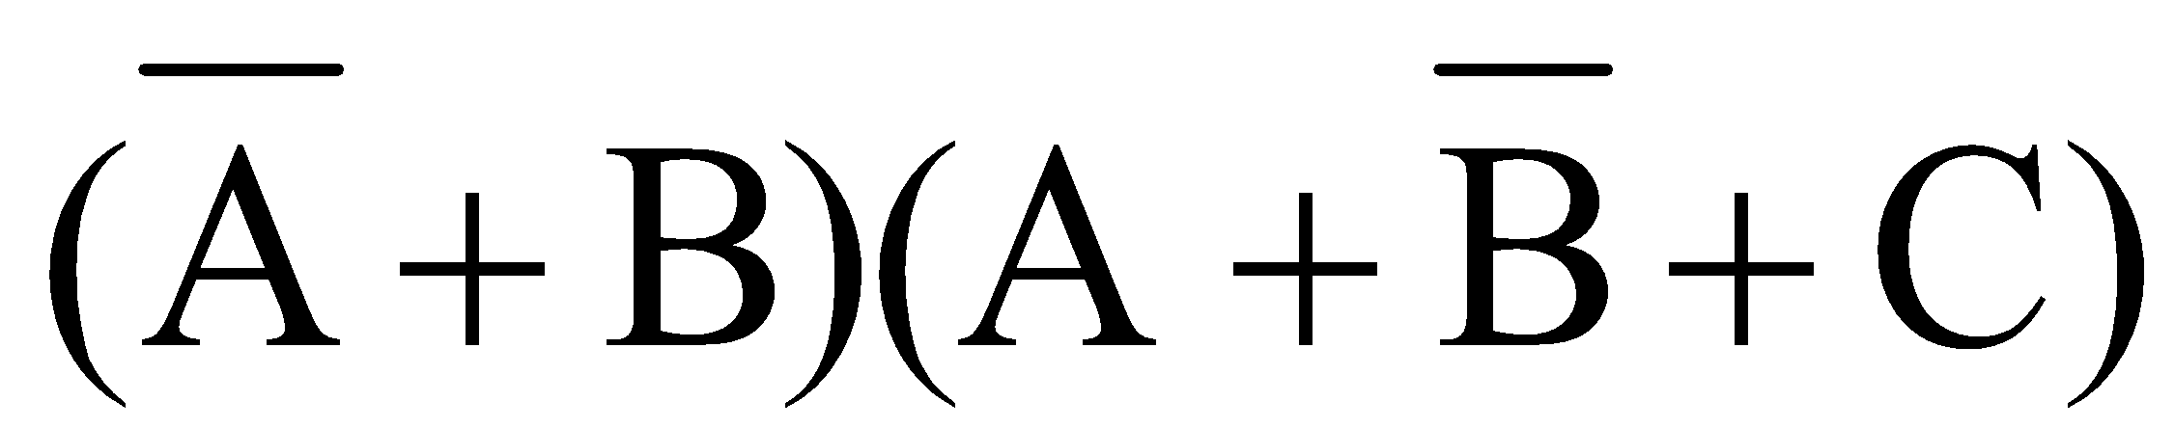
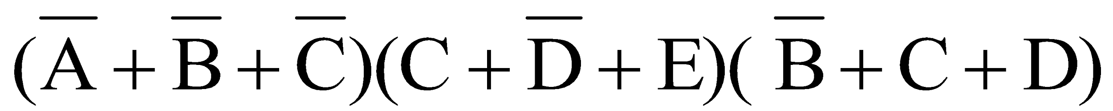
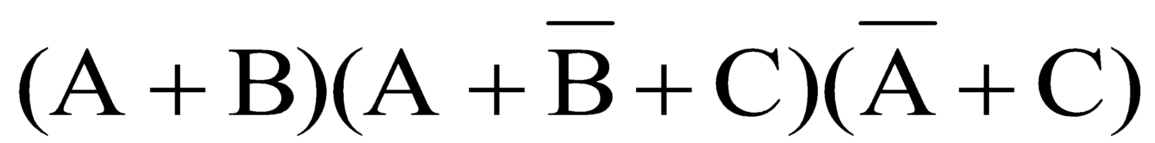
Standard forms of Boolean Expressions
Sum-of-Products form
AB + ABC
ABC + CDE +
Product-of-Sums form
Notes:
‹#›

Slide 28
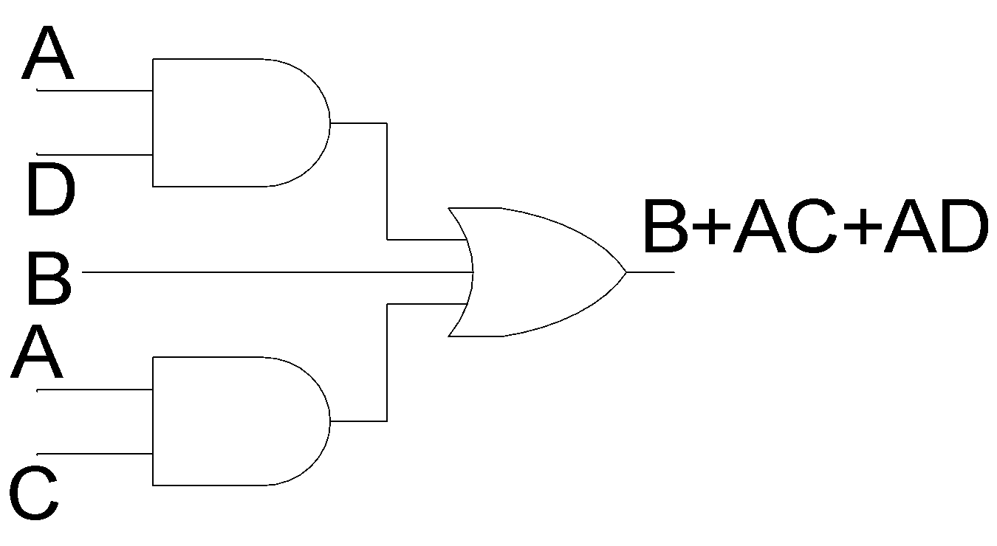
Implementation of SOP expression

Slide 29
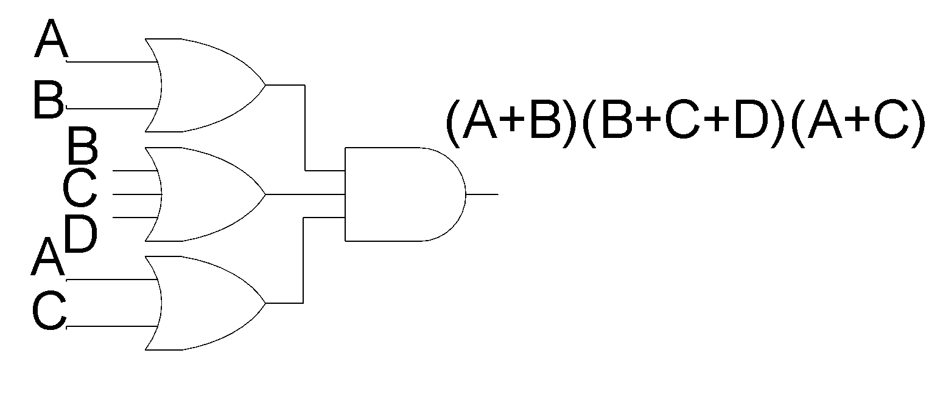
Implementation of POS expression

Slide 30

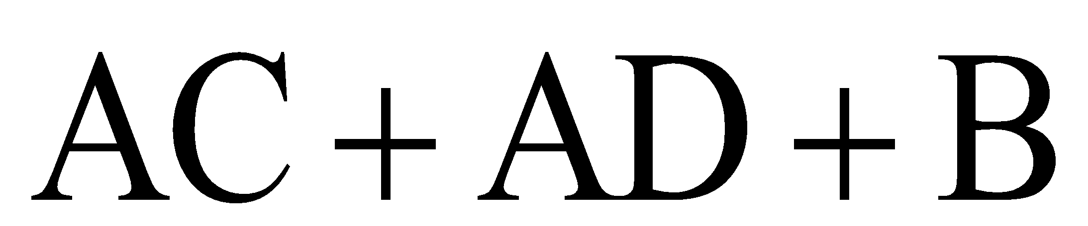
Conversion of general expression to SOP form
Notes:
‹#›
Any logical expression can be converted into SOP form by applying techniques of Boolean Algebra

